Slide 1
Pytorch without the deep learning (shallow learning?)
Jelmer Cnossen – 10/2/2023

Slide 2
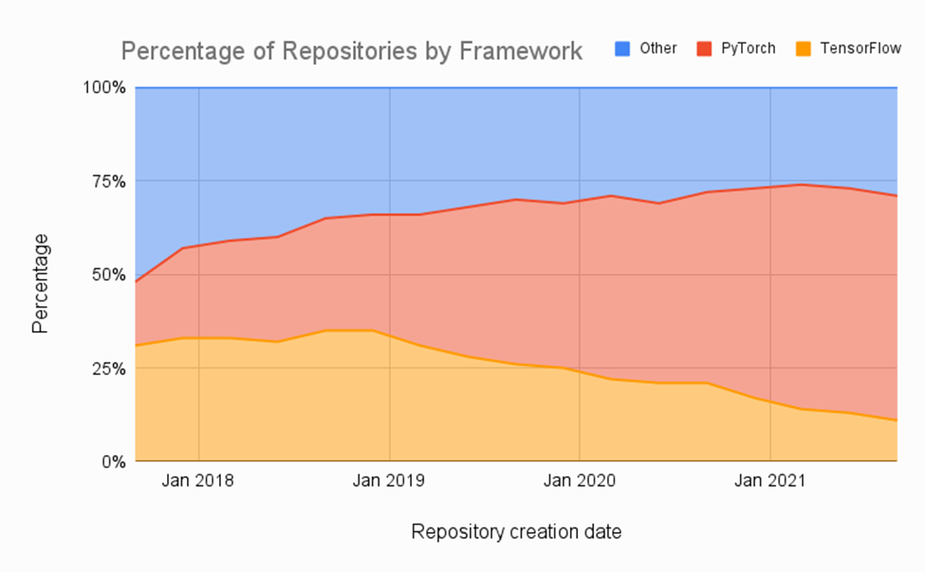
What is PyTorch?
It’s a python based numerical computing library originally developed by Facebook Research, for deep learning (DL)
Now the most popular DL framework
Can be used as a faster alternative to numpy
Is able to automatically compute derivatives for almost any function

Slide 3
Installing on your own PC
You need a python environment
I recommend anaconda, or the faster alternative (mambaforge):
https://github.com/conda-forge/miniforge#mambaforge
Create a python environment:
“conda create –n pytorch_test python=3.10 spyder”
And activate it
“conda activate pytorch_test”
If your PC has an nVidia card, install cuda
https://developer.nvidia.com/cuda-11-7-0-download-archive
Then, install pytorch using conda:
“conda install pytorch torchvision torchaudio pytorch-cuda=11.7 -c pytorch -c nvidia”

Slide 4
Using google colab
https://colab.research.google.com/
Free, but turns off the server if you don’t use the browser for a while, or up to 12 hours
All data is lost when your server stops

Slide 5
Numpy vs pytorch
Both use n-dimensional arrays. In pytorch called “tensors”
Converting from numpy to pytorch: often just trivial changes, sometimes not
Numpy | PyTorch | Note
np.array([1,2,3]) | torch.tensor([1,2,3]) | Array from constants
np.zeros((N, M)) | torch.zeros((N,M)) | Array filled with zeros
np.stack((A,B),axis=1) | torch.stack((A,B), dim=1) | Stack arrays in new dimension
np.concatenate((A,B),axis=1) | torch.cat((A,B), dim=1) | Concatenation along existing dimension
A.sum(axis=1, keepdims=True) | A.sum(dim=1, keepdim=True) | Sum over array dimension
values = np.max(A, axis, keepdims) | values, indices = torch.max(A, dim, keepdim) | Find maximum value over dimension. Torch version also returns indices like A.argmax()
np.linalg.solve(A,B) | torch.linalg.solve(A,B)
np.linalg.polyfit | Nope, implement yourself with torch.lstsq
A.reshape(shape) | A.reshape(shape) | Shape being a tuple like (rows, cols,…)
np.repeat(A, n, axis=0) | torch.repeat_interleave(A, n, dim=0) | np.repeat([1,2,3], 2) gives [1,1,2,2,3,3]

Slide 6
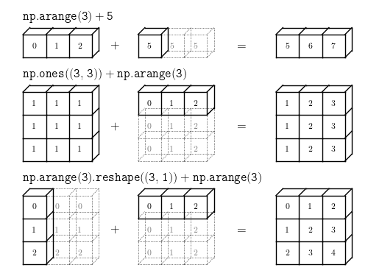
What is array broadcasting?
The problem:
How to combine arrays with different number of dimensions?
Take array A and B, with shapes [2,3] and [3,4]
General rules to define n-dimensional array operations:
Start with right most dimension
Size can be either 1 or equal
Examples:
zeros((3,4)) + arange(4), both last dimensions have size 4
zeros((3,4)) + arange(3), fails
zeros((3,4)) + arange(3).reshape((3,1)) works, size 1 combines with size 4
Inserting dimensions with A[None]
A[:, None] adds a new dimension with size 1
zeros((3,4) + arange(3)[:, None] also works and doesn’t require you to enter sizes again

Slide 7
GPU vs CPU arrays
GPU can give massive speedup
Especially with large enough arrays, easily > 10x
Lookup torch.jit.script for even more speedups, but more limitations
All torch commands that create arrays have a ‘device’ parameter
Arrays can be created on CPU or CUDA device
Or moved using the .cpu() or .cuda()
Annoyingly, you have to move it back to CPU to allow plotting
dev = torch.device(‘cuda’)
A = torch.arange(10, device=dev)
import matplotlib.pyplot as plt
plt.plot(A.cpu().numpy())

Slide 8
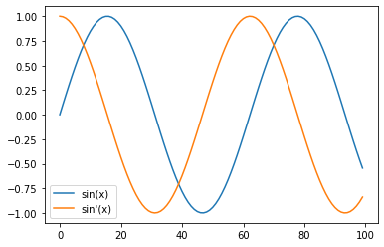
Computing gradients
Pytorch gradient methods are typically to compute the derivatives w.r.t. a single value (the loss in a deep learning problem)
If you use any tensor with requires_grad set to True, pytorch will keep track of the chain of calculations
Recent improvement allow for more complex cases, calculating derivatives w.r.t many outputs
import torch
import matplotlib.pyplot as plt
def to_numpy(x):
return x.detach().cpu().numpy()
x = torch.linspace(0, 10, 100)
x.requires_grad = True
y = torch.sin(x)
plt.plot(to_numpy(y), label='sin(x)')
y_deriv = torch.autograd.grad(y, x, torch.ones_like(y))[0]
plt.plot(to_numpy(y_deriv), label="sin'(x)")
plt.legend()

Slide 9
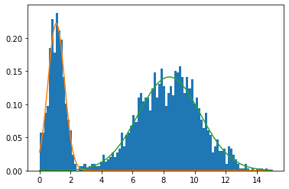
Max-likelihood estimation with gradient descent
Using torch.optim.Adam optimizer to gradient descent
# 1D Gaussian mixture model with two components
import torch
import matplotlib.pyplot as plt
import numpy as np
def to_numpy(x):
return x.detach().cpu().numpy()
def normal_prob(x, mu, std):
return torch.exp(-0.5 * ( (x - mu) / std )**2) / (std * np.sqrt(2*torch.pi))
# Define the 2 gaussian distributions
true_weights = torch.tensor([0.3, 0.7])
true_means = torch.rand(2)*10#([3, 8], dtype=torch.float32)
true_std = torch.tensor([0.5, 2], dtype=torch.float32)
N = 2000 # Number of samples
# Generate samples
smp_comp = torch.multinomial(true_weights, N, replacement=True)
samples = torch.normal(true_means[smp_comp], true_std[smp_comp])
# Plot our sample data
plt.hist(to_numpy(samples), bins=100, range=[0, 15], density=True)
# Problem parameters to estimate
est_weights = torch.ones(2)*0.5
est_means = torch.tensor([1, 10],dtype=torch.float32)
est_std = torch.tensor([2,2],dtype=torch.float32)
parameters = [est_weights, est_means, est_std]
for p in parameters:
p.requires_grad = True

Slide 10
Max-likelihood estimation with gradient descent
Using torch.optim.Adam optimizer to gradient descent
# Create an optimizer
optimizer = torch.optim.Adam(parameters, lr=0.1)
for i in range(100):
optimizer.zero_grad()
# Calculate the probability of each sample for each normal distribution, size [N, 2]
smp_prob_per_comp = normal_prob(samples[:,None], est_means[None], est_std[None])
# Probability per sample, size [N]
smp_prob = ( (est_weights / est_weights.sum())[None] * smp_prob_per_comp).sum(1)
# Define the total log-probability for the GMM,
# iaw probability of getting all these samples with current estimated distribution
total_log_prob = -torch.log(smp_prob).sum() # The optimizer will minimize, so we minimize the negative log-prob
total_log_prob.backward()
print(f"Total log-prob: {to_numpy(total_log_prob):.2f}. est_weights:{to_numpy(est_weights)}")
optimizer.step()
with torch.no_grad():
est_weights.clamp_(0,1)
est_weights /= est_weights.sum()
with torch.no_grad():
x = torch.linspace(0, 15, steps=200)
for i in range(2):
plt.plot(x, to_numpy( est_weights[i] * normal_prob(x, est_means[i], est_std[i]) ) )

Slide 11
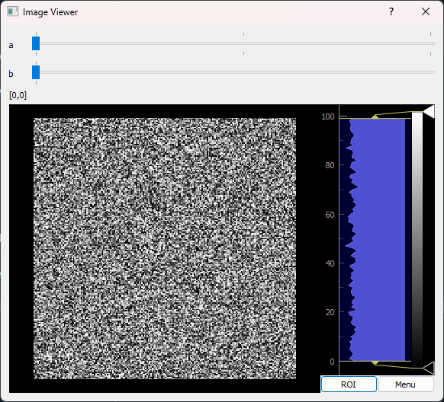
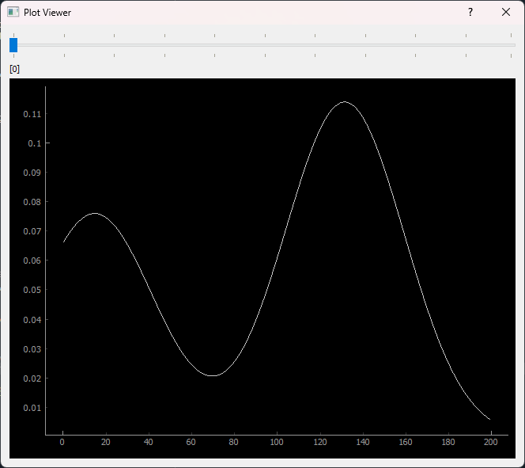
Some debugging tricks and code
Spyder IDE
Using “%pdb on” will trigger the debugger whenever python throws an exception
Within the debugger, use ‘u’ and ‘d’ commands to go up and down the functions that are called (the ‘call stack’)
N-d plot and image viewer
See array_view.py
Also runs within debugger

Slide 12
Writing a custom Module
Integrates better with regular DL code, inserting custom math into a deep learning approach.
See full code in gmm_module.py
class GMM(torch.nn.Module):
"""
Calculates probability in a gaussian mixture model
"""
def __init__(self, weights, means, std):
super().__init__()
self.weights = torch.nn.Parameter(weights, requires_grad=True)
self.means = torch.nn.Parameter(means, requires_grad=True)
self.std = torch.nn.Parameter(std, requires_grad=True)
def forward(self, samples):
# Calculate the probability of each sample for each normal distribution, size [N, 2]
smp_prob_per_comp = normal_prob(samples[:,None], self.means[None], self.std[None])
# Probability per sample, size [N]
smp_prob = ( (self.weights / self.weights.sum())[None] * smp_prob_per_comp).sum(1)
return smp_prob
def sample(self, num_samples):
# Generate samples
with torch.no_grad():
smp_comp = torch.multinomial(self.weights, num_samples, replacement=True)
samples = torch.normal(self.means[smp_comp], self.std[smp_comp])
return samples, smp_comp
def normalize_weights(self):
with torch.no_grad():
self.weights.clamp_(0,1)
self.weights /= self.weights.sum()

